Slide 1
Discussion Unit: DSE Analytics
The goal of this Discussion Unit is to configure and use DSEFS.
DSEFS
Notes:
The goal of this Discussion Unit is to configure and use DSEFS.
Reference Urls:
https://docs.datastax.com/en/dse/6.0/dse-admin/datastax_enterprise/analytics/dsefsTOC.html

Slide 2
Discussion Lab:
DSE Analytics; DSEFS, HDFS, NAS, RDD, Map/Reduce
Matching pairs – Match the attributes on the right with the areas on the left
Notes:
On the next page we enter a Discussion Lab.

Slide 3


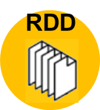



DSE Analytics: HDFS, RDD, DSEFS, M/R, NAS
Core to Spark
Core to Hadoop
POSIX compliant
DSEFS
Local to computation
Map/
Reduce
Remote from computation
Schema on read
SAN
Schema on write
Notes:
Matching pairs Discussion Lab: properties of HDFS, RDDs, DSEFS, Map/Reduce, NAS
Match the terms on the right with the objects on the left.
Reference Urls,
https://www.edureka.co/blog/interview-questions/hadoop-interview-questions-hdfs-2/
Portable Operating System Interface (POSIX), https://en.wikipedia.org/wiki/POSIX#cite_note-1

Slide 4
End of Discussion Lab:
Notes:
End of Discussion Lab-

Slide 5

DSEFS: What and Why
Staging for import/export
Intermediate results in a DAG, Workflow
Distributing Jars; save work for driver and executor
Scan heavy workloads
Unstructured data
DSE 5.0+ (CFS, 2.0 to 5.1)
HDFS compatible storage
Compression (HW level encryption)
Shared nothing
Same JVM as DSE Core
Secure, Local DSE, LDAP, Kerberos, also TLS/SSL
Performant; option to disable fsync
Notes:
No additional notes-

Slide 6
DSEFS: Features
Creating, listing, moving, renaming, deleting files and directories, wildcard expansion
Optional password / token authentication and Kerberos authentication in Spark
POSIX permissions and file attributes
Interactive console with access to DSEFS, local file system, and other HDFS-compatible filesystems
Querying block locations for efficient data local processing in Spark or Hadoop
Replication and block size control
Transparent optional LZ4 compression
Utility to check filesystem integrity (fsck)
Utility to view status of the cluster (e.g. disk usage)
Notes:
Reference Urls,
https://www.datastax.com/dev/blog/from-cfs-to-dsefs

Slide 7
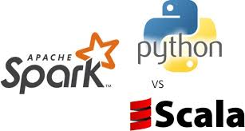
DSEFS: Just DSE Analytics (Apache Spark)
Checkpointing (DAG)
Distributing Jars; save work for driver and executor
Intermediate results; (Parquet, good choice)
Starts by default with DSE Analytics
dse.yaml
Prefer; separate disk-drive/controller
Managed as Keyspace; RF and Replication Strategy
Also RF per directory, per file
One per DC. Multiple DCs ?, Different DSEFS names
Notes:
No additional notes-

Slide 8
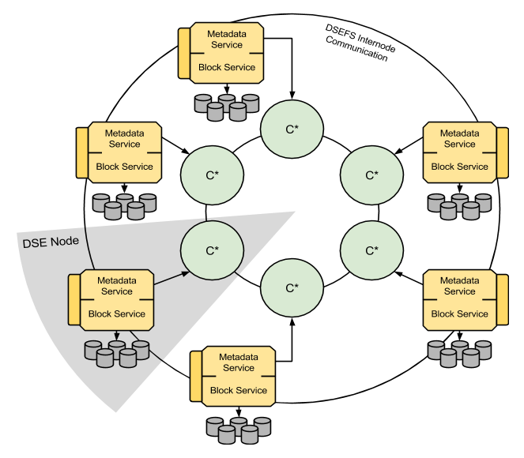
DSEFS: Architecture
No single point of failure; shared nothing
Same JVM as DSE Core
Notes:
The major difference between CFS and DSEFS architectures is that in DSEFS the data storage layer is separate from the metadata storage layer. Metadata, which includes information about paths, file names, file attributes, as well as pointers to data, are stored in Cassandra tables. File data are stored outside Cassandra, directly in the node's local file system. Data is split into blocks, each 64 MB large by default, and each block is stored in its own file.
Storing data blocks in the local file system has several advantages:
There is virtually no limit on the number of blocks that can be stored, other than the capacity of storage devices installed in the cluster. Blocks at rest do not take any other system resources such as memory or file descriptors.
The DSEFS server can stream a data block over the network very efficiently using sendfile without copying any part of it to JVM heap nor userspace memory.
Writing data to blocks skips the Cassandra commit log, so every block needs to be written only once.
Deleting files is fast and space is reclaimed immediately. Each block is stored in its own file in some storage directory, so deleting a file from DSEFS is just deleting files from the local file system. There is no need to wait for a compaction operation.
Looking up blocks is faster than accessing sstables. Blocks can be quickly accessed directly by their name which is stored in the metadata.
Replication for data can be configured in a very fine grained way, separately from Cassandra replication. For example files in one directory can have RF=3 and files in another directory can have RF=5. You can also set replication factor for each file.
Data placement is much more flexible than what can be achieved with consistent hashing. A coordinator may choose to place a block on the local node to save network bandwidth or to place a block on the node that has low disk usage to balance the cluster.
Using Cassandra to store metadata has also many advantages:
The Cassandra tabular data model is well suited for efficient storage and quick lookup of information about files and block locations. Metadata is tiny compared to data, and comprised of pieces of information of such types that Cassandra can handle well.
Cassandra offers excellent scalability, with capacity not limited by the amount of memory available to a single server (such as for an HDFS NameNode). This means DSEFS can store a virtually unlimited number of files.
The shared-nothing architecture of Cassandra offers strong high availability guarantees and allows DSEFS to be shared-nothing as well. Any node of your cluster may fail and DSEFS continues to work for both reads and writes. There are no special "master" nodes like HDFS NameNode. Hence, there are no single points of failure, even temporary. DSEFS clients can connect to any node of the DSE cluster that runs DSEFS.
Cassandra lightweight transactions allow to make some operations atomic within a data center, e.g. if multiple clients in the same data center request to create the same path, at most one will succeed.
Cassandra offers standard tools like cqlsh to query and manipulate data. In some cases it may be useful to have easy access to internal file system metadata structures, e.g. when debugging or recovering data.
Reference Urls:
https://www.datastax.com/dev/blog/from-cfs-to-dsefs

Slide 9
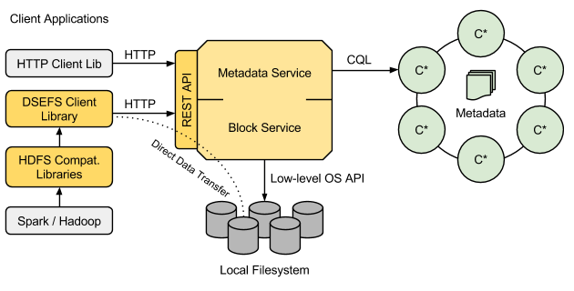
DSEFS: Architecture
Metadata is DSE Core
Data-data as blocks on DSEFS
Notes:
Clients may talk to any node by HTTP to port 5598. The contacted node becomes the coordinator for the request. When accessing a file, the coordinator consults the metadata layer to check if the file exists, then to check permissions and finally to get the list of block identifiers and block locations. Then it fetches the blocks either from local block layer or from remote nodes by using DSEFS internode communication on port 5599. The coordinator joins blocks together and streams them to the client. In the future we may implement an optimization to skip the coordinator and request and join blocks directly by the client.
When writing a file, first the appropriate records are created in the metadata to register the new file, then the incoming data stream is split into blocks and sent to the appropriate block locations. After successfully writing a block, metadata is updated to reflect that fact.
DSEFS Implementation
DSEFS has been implemented in the Scala programming language. It uses Netty for network connectivity, memory management and asynchronous task execution.
Netty together with Scala-Async allow for non-blocking, asynchronous style of concurrent programming, without callback hell and without explicit thread synchronization. A small number of threads is multiplexed between many connections. A request is always handled by a single thread. This thread-per-core parallelism model greatly improves cache efficiency, reduces the frequency of context switches and keeps the cost of connections low. Connections between the client and the server as well as between the nodes are persistent and shared by multiple requests.
DSEFS allocates buffers from off-heap memory with Netty pooled allocator. JVM heap is used almost exclusively for temporary, short-lived objects. Therefore DSEFS is GC friendly. When internally testing the DSEFS server in standalone mode, external to DSE, we've been able to use JVM heaps of size as low as 64 MB (yes, megabytes) without a noticeable drop in performance.
Contrary to CFS, DSEFS doesn't use the old Thrift API to connect to DSE. Instead, it uses DataStax Java Driver and CQL. CFS was the last DSE component using Thrift, so if you migrate your applications to DSEFS, you can simply disable Thrift API by setting cassandra.yaml start_rpc property to false.
Reference Urls:
https://www.datastax.com/dev/blog/from-cfs-to-dsefs

Slide 10

DSEFS: Roundtrip using DSE Spark
val rows = sc.textFile(
"file:///opt/stores_db/7545_HelloWorld.csv")
rows.collect().foreach(println)
rows.saveAsTextFile(
"dsefs:///tmp/7545_HelloWorld.csv")
Notes:
Scala code to send data from operating system CSV into DSEFS.

Slide 11


DSEFS: Verify via "dse fs"
# dse fs
dsefs dsefs://127.0.0.1:5598/ > ls -l
Type Permission Owner Group Length Modified Name
dir rwx-wx-wx none none - 2018-07-19 17:09:49-0600 tmp
dsefs dsefs://127.0.0.1:5598/ > cd tmp
dsefs dsefs://127.0.0.1:5598/tmp/ > ls -l
Type Permission Owner Group Length Modified Name
dir rwx-wx-wx none none - 2018-07-19 17:09:49-0600 hive
... After job on previous page runs
dsefs dsefs://127.0.0.1:5598/tmp/ > ls -l
Type Permission Owner Group Length Modified Name
dir rwxrwxrwx none none - 2018-07-19 17:21:54-0600 7545_HelloWorld.csv
dir rwx-wx-wx none none - 2018-07-19 17:09:49-0600 hive
Notes:
Using the "dse fs" utility:
Each of the commands in blue can be run directly. E.g., dse fs "ls –l"
/tmp will pre-exist, as will /tmp/hive
Notice that the uploaded file is stored as a directory. Why ?

Slide 12
DSEFS: Verify via "dse fs"
dsefs dsefs://127.0.0.1:5598/tmp/ > cd 75*
dsefs dsefs://127.0.0.1:5598/tmp/7545_HelloWorld.csv/ > ls -l
Type Permission Owner Group Length Modified Name
file rw-r--r-- none none 0 2018-07-19 17:21:55-0600 _SUCCESS
file rw-r--r-- none none 48 2018-07-19 17:21:54-0600 part-00000
file rw-r--r-- none none 15 2018-07-19 17:21:55-0600 part-00001
dsefs dsefs://127.0.0.1:5598/tmp/7545_HelloWorld.csv/ > cat part*
111, Bob, Mary
222, Ted
333, Alice, Bob, Harold
444, Dave, Bob
dsefs dsefs://127.0.0.1:5598/tmp/7545_HelloWorld.csv/ >
Notes:
Using the "dse fs" utility:
Notice the use of wildcard file naming.
Notice the output of cat.

Slide 13
DSEFS: Settings, dse.yaml
dsefs_options:
enabled:
keyspace_name: dsefs
work_dir: /var/lib/dsefs
public_port: 5598
private_port: 5599
data_directories:
- dir: /var/lib/dsefs/data
storage_weight: 1.0
min_free_space: 5368709120 # Change to 1024 for dev
" ... DSEFS nodes are either unavailable or low on free space ... "
Notes:
On a small, development laptop virtual machine, you may have to set min_free_space, to get DSEFS to work, values in bytes; error message as shown at bottom of page.
Reference Urls,
https://docs.datastax.com/en/dse/6.0/dse-admin/datastax_enterprise/analytics/enablingDsefs.html
https://stackoverflow.com/questions/49238402/there-are-no-available-dsefs-locations-to-write-data-to

Slide 14

All of DSE Analytics: Keyspace RF/Strategy
dse_analytics
dse_leases
dsefs
"HiveMetaStore"
See DSE Core Practice Lab, 6207/Keyspaces
Different; 1 DSEFS per DC
ALTER KEYSPACE dsefs
WITH REPLICATION = {
'class': 'NetworkTopologyStrategy',
'Analytics': '3'};
Notes:
Reference Urls:
https://docs.datastax.com/en/dse/6.0/dse-admin/datastax_enterprise/analytics/settingReplFactorAnalyticsKeyspaces.html

Slide 15
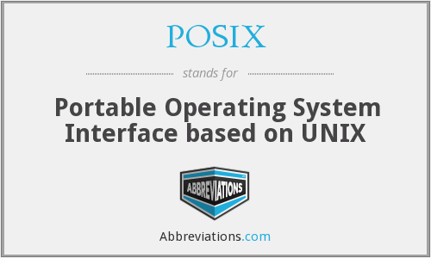
DSEFS: Nearly POSIX compliant
append
cat
cd
chgrp, chmod, chown
cp
df
echo
exit
fsck
get
ls
mkdir, rmdir, rm [ -r ]
mv, rename
put
pwd, realpath
stat
truncate
umount
Notes:
Reference Urls,
https://docs.datastax.com/en/dse/6.0/dse-admin/datastax_enterprise/analytics/commandsDsefs.html

Slide 16
DSEFS: REST Interface
curl -L -X PUT 'localhost:5598/webhdfs/v1/fs/a/b/c/d/e?op=MKDIRS'
curl -L -X PUT -T logfile.txt
'127.0.0.1:5598/webhdfs/v1/fs/log?op=CREATE&overwrite=\
true&blocksize=50000&rf=1'
curl -L -X POST logfile.txt \
'localhost:5598/webhdfs/v1/fs/log?op=APPEND'
Or from the DSE Spark shell:
val rdd1 = sc.textFile(
"webhdfs://localhost:5598/webhdfs/v1/fs/log")
Notes:
Reference Urls:
https://docs.datastax.com/en/dse/6.0/dse-admin/datastax_enterprise/analytics/dsefsRestInterface.html

Slide 17
End of Unit:
Notes:
End of Discussion Unit-

Slide 18
Additional Detail:
Notes:
The remaining content may be read “extra credit”, as time allows.

Slide 19
Using HDFS
Not part of the DSE system but is part of Hadoop
Can be used for long term data storage
Spark is able to connect to any existing HDFS
Additionally Spark is designed to be file system independent
Thus Spark can also connect to systems like HBase or S3
Notes:
No additional notes-

Slide 20
DSEFS Compared to: HDFS, CFS
Benefits of DSEFS over HDFS
Benefits of DSEFS over CFS
No single point of failure
No impact on DSE Core
No NameNode
No overhead from compactions, commit log writes
No SecondaryNameNode
No data density impact
No Zookeeper
Immediate deletes, no overhead
Notes:
No additional notes-

Slide 21
DSEFS Questions:
What should the replication factor be on metadata?
What should be the replication factor on a given file?
What if the file is a jar needed to run a spark job (dse spark-submit -jars dsefs://myjob/jars/xyz.jar)?
Where would you use DSEFS?
Does DSEFS data count towards data density on a DSE node?
Why use webhdfs?
Notes:
Answer the questions above-

